Slide 1
My Presentation
Philip starck

Slide 2


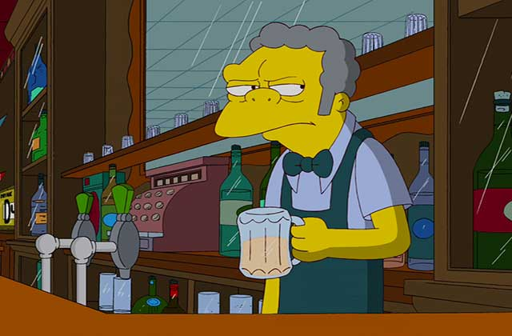





ABOUT ME
My Job Experience
My Future
my favorite languages
Now

